Slide 1

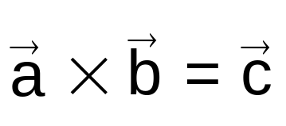
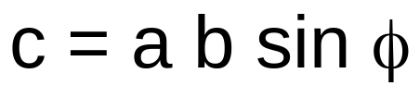




3-6 Multiplying Vectors
Vector Product
Vector quantity
The smaller angle of the two angles between a and b
Vector product is also called cross product and read as a cross b.
The direction of c is perpendicular to the plane that contains a and b
If a and b are in the plane of the paper, c will be perpendicular to the paper .
Right-hand rule
Your thumb of your right hand points along the direction of the cross product c if
your index finger points along the direction of the first vector a
and
your middle finger points along the second vector b.
right hand

Slide 2
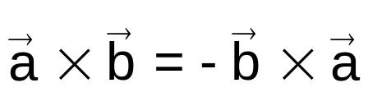
3-6 Multiplying Vectors
Vector Product
Right-hand rule
right hand
Out of the page
an arrow comes out of the page
Into of the page
an arrow goes
into the page

Slide 3




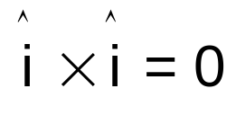
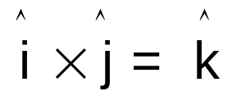


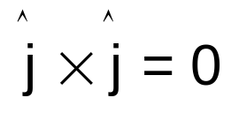
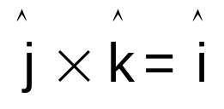

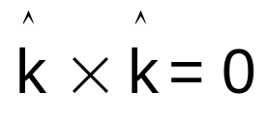
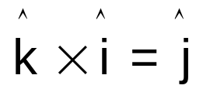



3-6 Multiplying Vectors
Vector Product
y
x
z
Note the order.
i always comes before j.
j always comes before k.
k always comes before i.
If they are not in this order, then the answer is negative.
Right-handed coordinate system
right hand

Slide 4
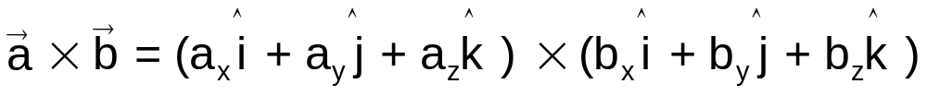
3-6 Multiplying Vectors
Vector Product in unit-vector notation

Slide 5
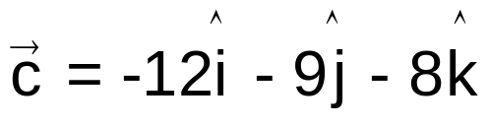
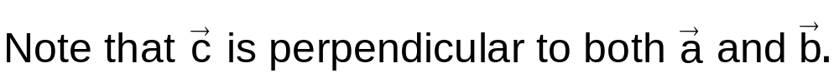
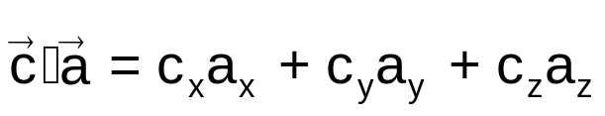
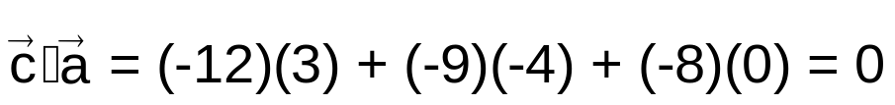
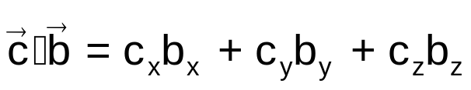
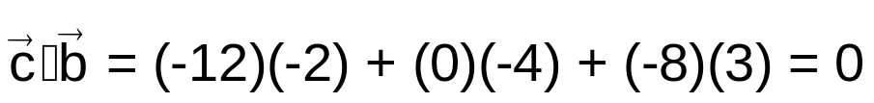
3-6 Multiplying Vectors
Example 8
Solution

Slide 6
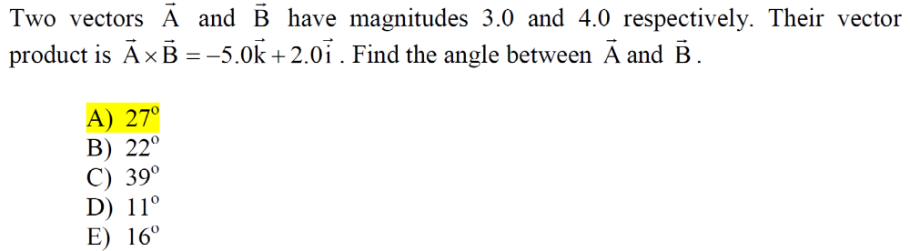

Slide 7
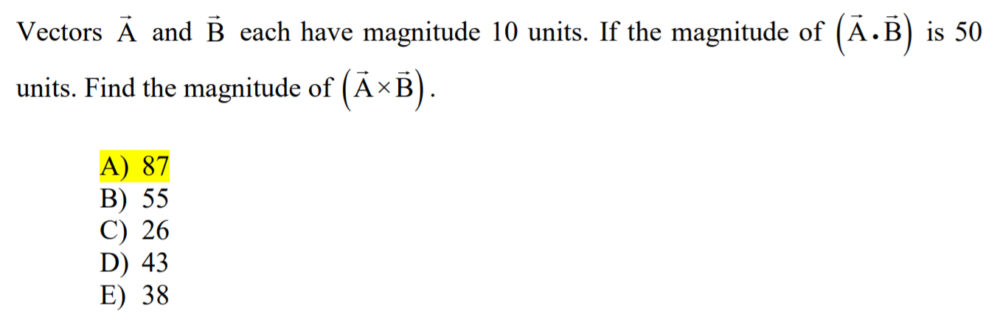

Slide 8
